Slide 1



Intro to text mining using tm, openNLP , & topicmodels
www.linkedin.com/in/edwardkwartler
@tkwartler

Slide 2


Shameless Plug
Slated for June 2016
*cover art may change.

Slide 3
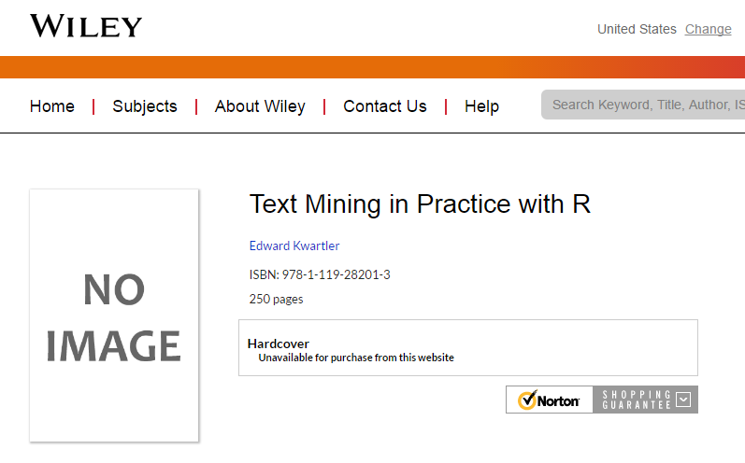
Shameless Plug #1
In final editing now!

Slide 4

Shameless Plug #2

Slide 5
Agenda
What is Text Mining?
String Manipulation
Cleaning
Freq Counts, Dendrograms
Wordclouds
Topic Modeling
openNLP

Slide 6
Agenda
What is Text Mining?
String Manipulation
Cleaning
Freq Counts, Dendrograms
Wordclouds
Topic Modeling
openNLP

Slide 7
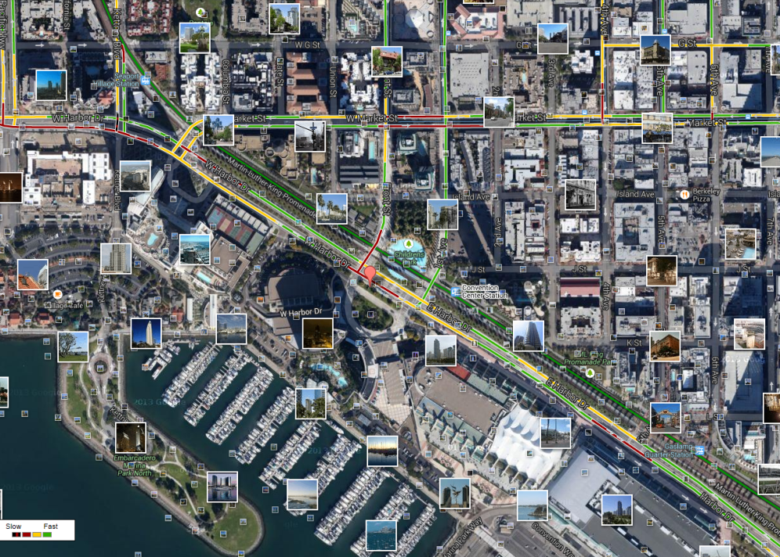
What is text mining?
Extract new insights from text
Let’s you drink from a fire hose of information
Language is hard; many unsolved problems
Unstructured
Expression is individualistic
Multi-language/cultural implications
Before Text Mining
What is Text Mining?

Slide 8
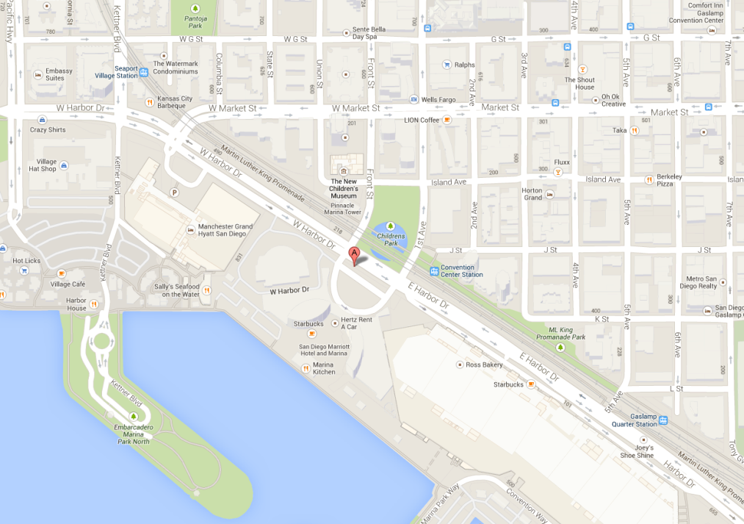
What is text mining?
Extract new insights from text
Let’s you drink from a fire hose of information
Language is hard; many unsolved problems
Unstructured
Expression is individualistic
Multi-language/cultural implications
After Text Mining
What is Text Mining?

Slide 9
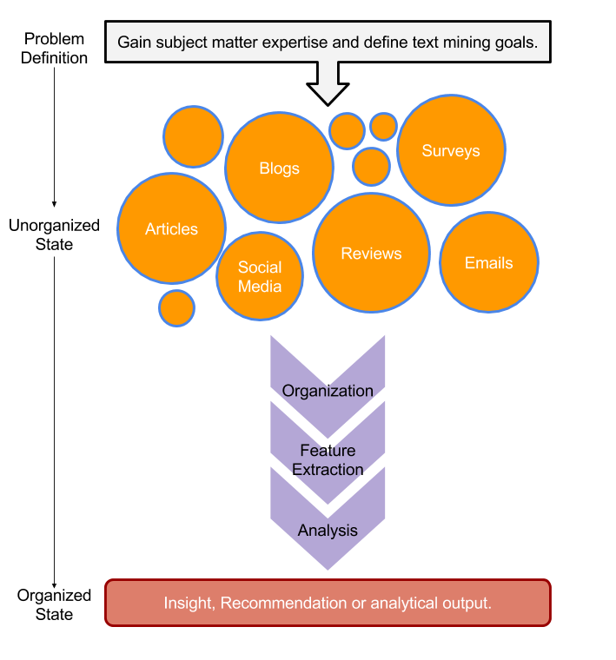
Text Mining Workflow
tweets
emails
surveys
Problem Definition
Identify Text Sources
Text Organization
Feature Extraction
Analytics
Reach Insight/Recommendation
blogs
reviews
articles
What is Text Mining?

Slide 10
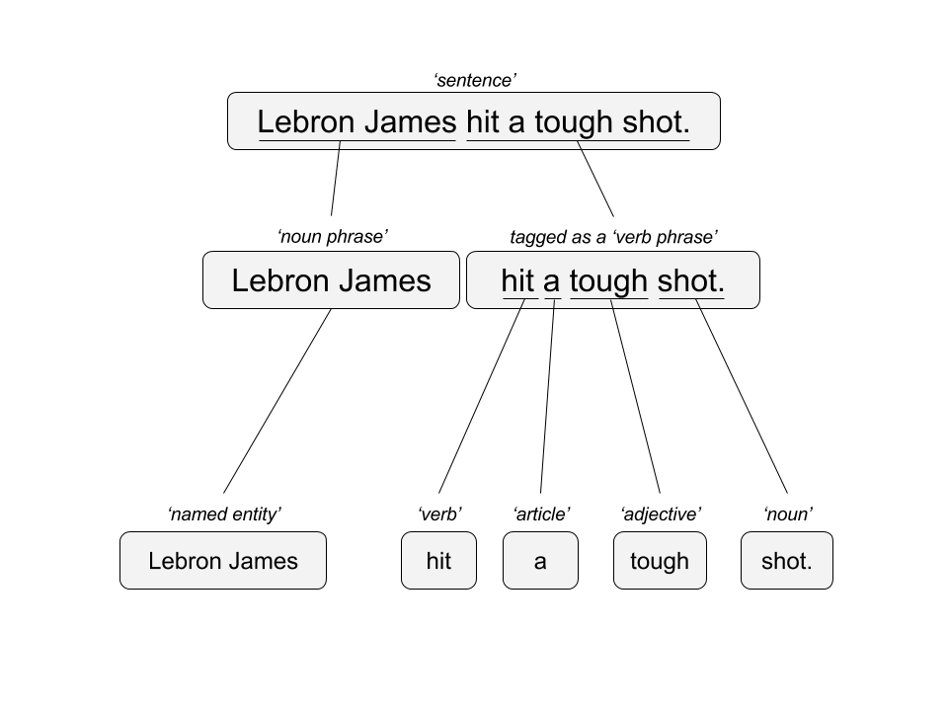

Text Mining Approaches
“Lebron James hit a tough shot.”
Semantic Using Syntactic Parsing
Bag of Words
Lebron
a
James
hit
tough
shot
What is Text Mining?

Slide 11
Text Mining Approaches
Some Challenges in Text Mining
“I made her duck.”
Compound words (tokenization) changes meaning
“not bad” versus “bad”
Disambiguation
Sarcasm
“I like it…NOT!”
Cultural differences
“It’s wicked good” (in Boston)
I cooked waterfowl to eat.
I cooked waterfowl belonging to her.
I created the (clay?) duck and gave it to her.
Duck!!
What is Text Mining?

Slide 12





Text Sources
Text can be captured within the enterprise and elsewhere
Books
Electronic Docs (PDFs)
Blogs
Websites
Social Media
Customer Records
Customer Service Notes
Notes
Emails
Legal Documents
…
The source and context of the medium is important. It will have a lot of impact on difficulty and data integrity.
What is Text Mining?

Slide 13
Enough of me talking…let’s do it for real!
Scripts in this workshop follow a simple workflow
Set the Working Directory
Load Libraries
Make Custom Functions & Specify Options
Read in Data & Pre-Process
Perform Analysis & Save
What is Text Mining?

Slide 14
Enough of me talking…let’s do it for real!
Setup
Install R/R Studio
Workshop scripts, corpora
(prob best to download at the end)
https://goo.gl/2WWkst
http://www.rstudio.com/products/rstudio/download/
http://cran.us.r-project.org/
Install Packages
Run “1_Install_Packages.R” script
An error may occur if the Java version doesn’t match and depending on the OS. In that case install packages individually.
What is Text Mining?

Slide 15
Warning: Twitter Profanity
Twitter demographics skew young and as a result have profanity that appear in the examples.
It’s the easiest place to get a lot of messy text fast, if it is offensive feel free to talk to me and I will work to get you other texts for use on your own. No offense is intended.
#%@*!!!

Slide 16
Keyword Scanning & Text Cleaning
What is Text Mining?
String Manipulation
Cleaning
Freq Counts, Dendrograms
Wordclouds
Topic Modeling
openNLP

Slide 17
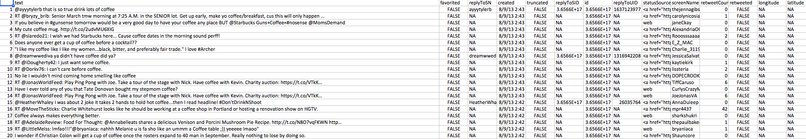
Open the “coffee.csv” to get familiar with the data structure
1000 tweets mentioning “coffee”
Setup
“text$text”
is the vector of tweets that we are interested in.
All other attributes are automatically returned from the twitter API
Keyword scanning, Cleaning & Freq Counts

Slide 18
2_Keyword_Scanning.R
Basic R Unix Commands
Setup
grepl returns a vector of T/F if the pattern is present at least once
grepl(“pattern”, searchable object, ignore.case=TRUE)
grep returns the position of the pattern in the document
grep(“pattern”, searchable object, ignore.case=TRUE)
“library(stringi)” Functions
stri_count counts the number of patterns in a document
stri_count(searchable object, fixed=“pattern”)
Keyword scanning, Cleaning & Freq Counts

Slide 19
2_String Manipulation.R

Slide 20
Remember This?
tweets
emails
surveys
blogs
reviews
articles
What is Text Mining?

Slide 21
R for our Cleaning Steps
Setup
Tomorrow I’m going to have a nice glass of Chardonnay and wind down with a good book in the corner of the county :-)
tweets
emails
Remove Punctuation
Remove extra white space
Remove Numbers
Make Lower Case
Remove “stop” words
blogs
reviews
articles
tomorrow going nice glass chardonnay wind down good book corner county
Keyword scanning, Cleaning & Freq Counts

Slide 22
3_Cleaning and Frequency Count.R
“library(tm)” Functions
VCorpus creates a corpus held in memory.
Setup
VCorpus(source)
tm_map applies the transformations for the cleaning
tm_map(corpus, function)
getTransformations() will list all standard tm corpus transformations
We can apply standard R ones too. Sometimes it makes sense to perform all of these or a subset or even other transformations not listed like “stemming”
tm_map(corpus, removePunctuation) - removes the punctuation from the documents
tm_map(corpus, stripWhitespace) - extra spaces, tabs are removed
tm_map(corpus, removeNumbers) - removes numbers
tm_map(corpus, tolower) – makes all case lower
tm_map(corpus, removeWords) - removes specific “stopwords”
New Text Mining Concepts
Corpus- A collection of documents that analysis will be based on.
Stopwords – are common words that provide very little insight, often articles like “a”, “the”. Customizing them is sometimes key in order to extract valuable insights.
Keyword scanning, Cleaning & Freq Counts

Slide 23
3_Cleaning and Frequency Counts.R

Slide 24
3_Cleaning and Frequency Count.R
“tryTolower”is poached to account for errors when making lowercase.
tryTolower <- function(x){
# return NA when there is an error
y = NA
# tryCatch error
try_error = tryCatch(tolower(x), error = function(e) e)
# if not an error
if (!inherits(try_error, 'error'))
y = tolower(x)
return(y)}
“clean.corpus” makes applying all transformations easier.
clean.corpus<-function(corpus){
corpus <- tm_map(corpus, removePunctuation)
corpus <- tm_map(corpus, stripWhitespace)
corpus <- tm_map(corpus, removeNumbers)
corpus <- tm_map(corpus, content_transformer(str_to_lower))
corpus <- tm_map(corpus, content_transformer(replace_contraction))
corpus <- tm_map(corpus, removeWords, custom.stopwords)
return(corpus)}
Base: tolower (basic)
Stringr: str_to_lower (wrapper)
Custom: tryTolower (handles errors)
Keyword scanning, Cleaning & Freq Counts

Slide 25
3_Cleaning and Frequency Count.R
“custom.stopwords” combines vectors of words to remove from the corpus
#Create custom stop words
custom.stopwords <- c(stopwords('english'), 'lol', 'smh')
“custom.reader” keeps the meta data (tweet ID) with the original document
#bring in some text
text<-read.csv('coffee.csv', header=TRUE)
#Keep the meta data, apply the functions to make a clean corpus
custom.reader <- readTabular(mapping=list(content="text", id="id"))
corpus <- VCorpus(DataframeSource(text), readerControl=list(reader=custom.reader))
corpus<-clean.corpus(corpus)
Keyword scanning, Cleaning & Freq Counts

Slide 26
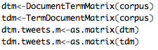
3_Cleaning and Frequency Count.R
Bag of Words means creating a Term Document Matrix or Document Term Matrix*
Term Document Matrix
Setup
Document Term Matrix
 | Tweet1 | Tweet2 | Tweet3 | Tweet4 | … | Tweet_n
Term1 | 0 | 0 | 0 | 0 | 0 | 0
Term2 | 1 | 1 | 0 | 0 | 0 | 0
Term3 | 1 | 0 | 0 | 2 | 0 | 0
… | 0 | 0 | 3 | 0 | 1 | 1
Term_n | 0 | 0 | 0 | 1 | 1 | 0
 | Term1 | Term2 | Term3 | … | Term_n
Tweet1 | 0 | 1 | 1 | 0 | 0
Tweet2 | 0 | 1 | 0 | 0 | 0
Tweet3 | 0 | 0 | 0 | 3 | 0
… | 0 | 0 | 0 | 1 | 1
Tweet_n | 0 | 0 | 0 | 1 | 0
“as.matrix” makes the tm’s version of a matrix into a simpler version
These matrices are often very sparse and large therefore some special steps may be needed and will be covered in subsequent scripts.
*Depends on analysis, both are transpositions of the other
Keyword scanning, Cleaning & Freq Counts

Slide 27
Dendrograms & Word Clouds
What is Text Mining?
String Manipulation
Cleaning
Freq Counts, Dendrograms
Wordclouds
Topic Modeling
openNLP

Slide 28
4_dendrogram.R script builds on the matrices
First let’s explore simple frequencies
Setup
#Summed Vector
tdm.m <- as.matrix(tdm)
tdm.v <- sort(rowSums(tdm.m),decreasing=TRUE)
tdm.df <- data.frame(word = names(tdm.v),freq=tdm.v, row.names=NULL)
Term Document Matrix
 | Tweet1 | Tweet2 | Tweet3 | Tweet4 | … | Tweet_n
Term1 | 0 | 0 | 0 | 0 | 0 | 0
Term2 | 1 | 1 | 0 | 0 | 0 | 0
Term3 | 1 | 0 | 0 | 2 | 0 | 0
… | 0 | 0 | 3 | 0 | 1 | 1
Term_n | 0 | 0 | 0 | 1 | 1 | 0
word | freq
Term1 | 0
Term2 | 2
Term3 | 3
… | 5
Term_n | 2
Setup
Freq Counts, Dendrograms
Wordclouds

Slide 29
4_dendrograms.R

Slide 30
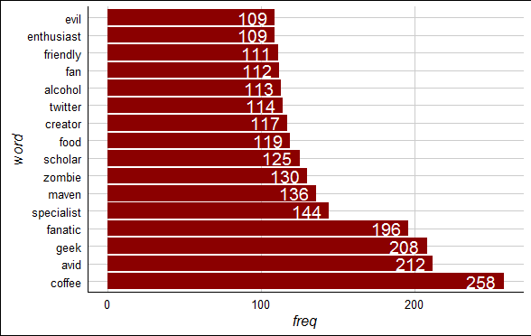
4_dendrogram.R script
ggplot2
ggthemes
#Make a barplot of the top terms
top.words<-tdm.df[which(tdm.df$freq>=105),]
top.words$word<-factor(top.words$word, levels=unique(as.character(top.words$word)))
ggplot(top.words, aes(x=word, y=freq))+geom_bar(stat="identity", fill='darkred') +coord_flip()+theme_gdocs()+
geom_text(aes(label=freq), colour="white",hjust=1.25, size=5.0)
“zombie” is an unexpected, highly frequent term. Let’s explore it.
Freq Counts, Dendrograms
Wordclouds

Slide 31
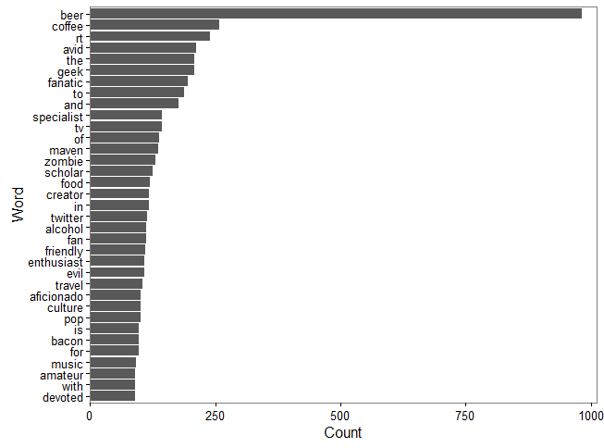
4_dendrogram.R script
“zombie” is an unexpected, highly frequent term. Let’s explore it.
plot(freq_terms(text$text, top=35, at.least=2))
qdap
base
Freq Counts, Dendrograms
Wordclouds

Slide 32
4_dendrogram.R script
Setup
Next let’s explore word associations, similar to correlation
associations<-findAssocs(tdm, 'zombie', 0.30)
a.df<-do.call(cbind,associations)
a.df<-data.frame(terms=row.names(a.df),a.df, row.names=NULL)
a.df$terms<-factor(a.df$terms, levels=a.df$terms)
ggplot(a.df, aes(y=terms)) + geom_point(aes(x=zombie), data=a.df)+
theme_gdocs()+geom_text(aes(x=zombie,label=zombie), colour="red",hjust=-.25)
Adjust 0.30 to get the terms that are associated .30 or more with the ‘zombie’ term.
Treating the terms as factors lets ggplot2 sort them for a cleaner look.
Freq Counts, Dendrograms
Wordclouds

Slide 33
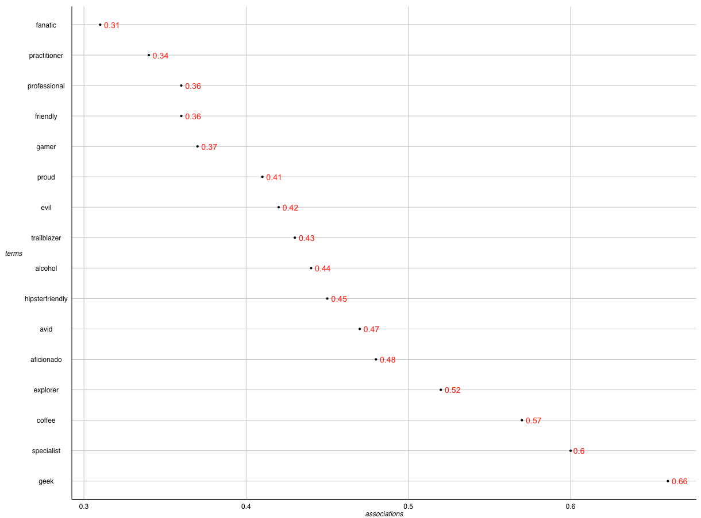
4_dendrogram.R script
“geek” has the highest word association with “zombie”.
Setup
Alcohol geek. Avid tv buff. Friendly beer aficionado. Coffee guru. Zombie junkie.
Freq Counts, Dendrograms
Wordclouds

Slide 34
Extracting Meaning using dendrograms
Dendrograms visualize hierarchical clusters based on frequencies.
Reduces information much like average is a reduction of many observations’ values
Word clusters emerge often showing related terms
Term frequency is used to construct the word cluster. Put another way, term A and term B have similar frequencies in the matrix so they are considered a cluster.
Setup
63
City | Annual Rainfall
Portland | 43.5
Boston | 43.8
New Orleans | 62.7
44
New Orleans
Boston & Portland are a cluster at height 44. You lose some of the exact rainfall amount in order to cluster them.
Boston
Portland
Freq Counts, Dendrograms
Wordclouds

Slide 35
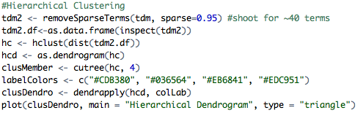
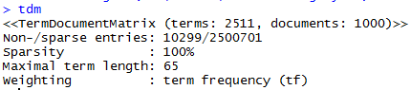
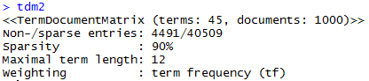
4_dendrogram.R script
Setup
Weird associations! Maybe a dendrogram will help us more
% of zeros allowed
e.g. higher means more words in TDM/DTM
New Text Mining Concept
Sparse- Term Document Matrices are often extremely sparse. This means that any document (column) has mostly zero’s. Reducing the dimensions of these matrices is possible by specifying a sparse cutoff parameter. Higher sparse parameter will bring in more terms.
Freq Counts, Dendrograms
Wordclouds

Slide 36
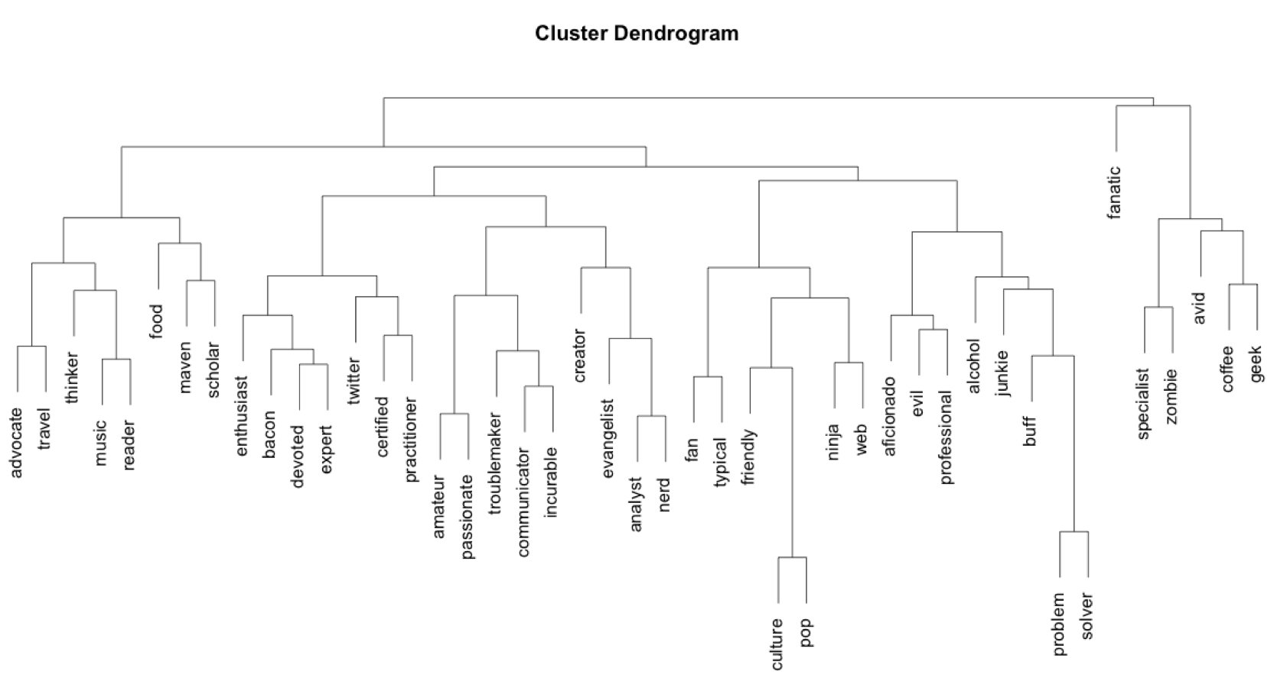
4_dendrogram.R script
Base Plot of a Dendrogram
Less visually appealing
Clusters can be hard to read given the different heights
Freq Counts, Dendrograms
Wordclouds

Slide 37
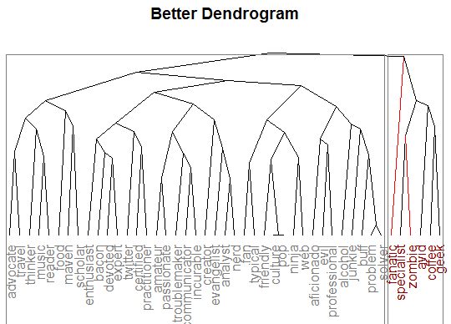
4_dendrogram.R script
hcd <- as.dendrogram(hc)
hcd <- branches_attr_by_labels(hcd, c('zombie','fanatic'), 'red')
hcd <- color_labels(hcd,2, col = c('grey50','darkred'))
plot(hcd, main = "Better Dendrogram", type='triangle',yaxt='n')
rect.dendrogram(hcd, k = 2, border = "grey50")
Dendextend offers more flexiblity
Aesthetically my choice is to have colored clusters and all terms at the bottom.
Freq Counts, Dendrograms
Wordclouds

Slide 38
5_Simple_Wordcloud.R

Slide 39
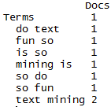
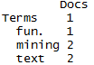
5_Simple_Wordcloud.R script
Using Rweka Package we create a custom function
tokenizer <- function(x) NGramTokenizer(x, Weka_control(min = 2, max = 2))
It is used as a control parameter when constructing a TDM/DTM
bigram_tdm <- TermDocumentMatrix(corpus, control = list(tokenize = tokenizer))
Text Mining is so fun. So do Text Mining!
Unigram
Bigram
*with common stopwords
New Text Mining Concept
Tokenization- So far we have created single word n-grams. We can create multi word “tokens” like bigrams, or trigrams with this line function. It is applied when making the term document matrix.
Freq Counts, Dendrograms
Wordclouds

Slide 40
5_Simple_Wordcloud.R script
To make a wordcloud we follow the previous steps and create a data frame with the word and the frequency.
#Summed Vector
tdm.m <- as.matrix(bigram_tdm)
tdm.v <- sort(rowSums(tdm.m),decreasing=TRUE)
tdm.df <- data.frame(word = names(tdm.v),freq=tdm.v)
Term Document Matrix
 | Tweet1 | Tweet2 | Tweet3 | Tweet4 | … | Tweet_n
Term1 | 0 | 0 | 0 | 0 | 0 | 0
Term2 | 1 | 1 | 0 | 0 | 0 | 0
Term3 | 1 | 0 | 0 | 2 | 0 | 0
… | 0 | 0 | 3 | 0 | 1 | 1
Term_n | 0 | 0 | 0 | 1 | 1 | 0
word | freq
Term1 | 0
Term2 | 2
Term3 | 3
… | 5
Term_n | 2
Setup
Freq Counts, Dendrograms
Wordclouds

Slide 41
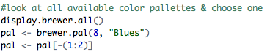
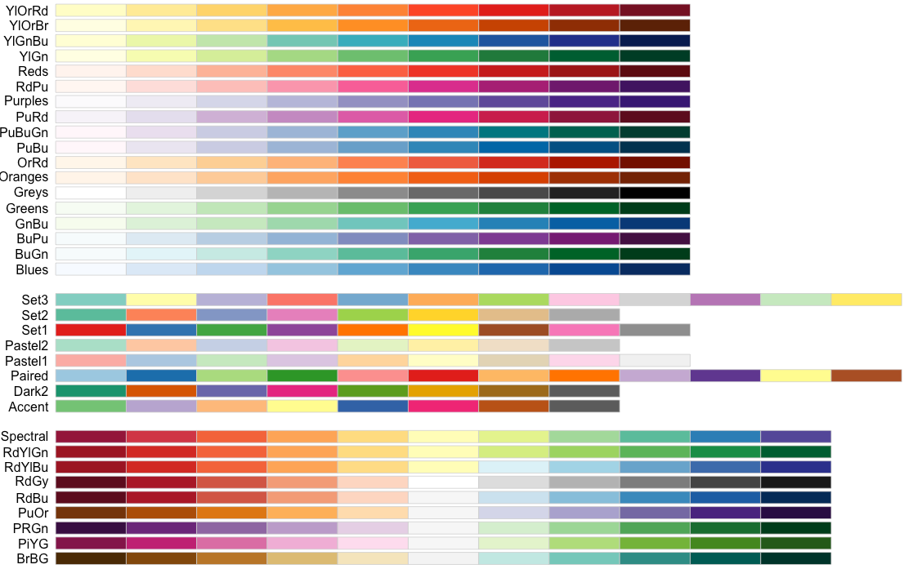
5_Simple_Wordcloud.R script
Next we need to select the colors for the wordcloud.
Freq Counts, Dendrograms
Wordclouds

Slide 42
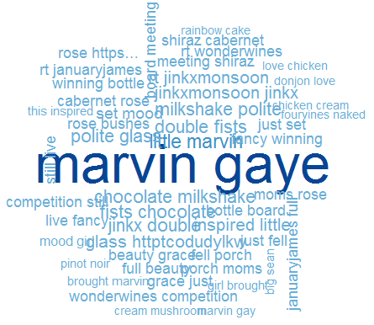
5_Simple_Wordcloud.R script
set.seed(2016)
wordcloud(tdm.df$word,tdm.df$freq,max.words=50, random.order=FALSE, colors=pal)
Bigram Tokenization has captured “marvin gaye”
A word cloud is a frequency visualization. The larger the term (or bigram here) the more frequent the term.
You may get warnings if certain tokens are to large to be plotted in the graphics device.
Freq Counts, Dendrograms
Wordclouds

Slide 43
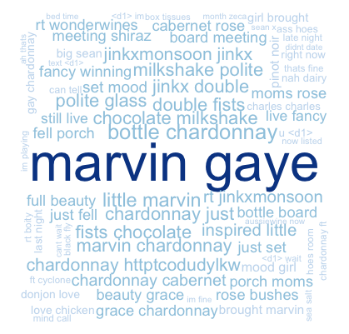
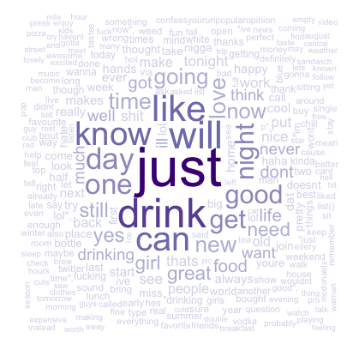
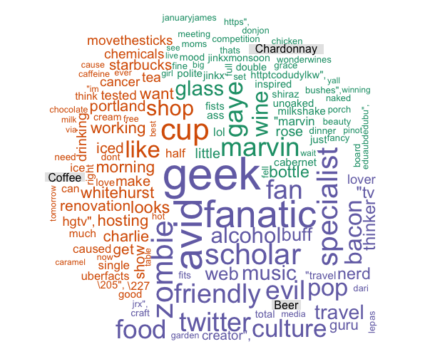
Types of Wordclouds
Single Corpus
Multiple Corpora
wordcloud( )
comparison.cloud( )
commonality.cloud( )
comparison.cloud( )
comparison.cloud( )
Freq Counts, Dendrograms
Wordclouds

Slide 44
6_Other_Wordclouds.R

Slide 45
6_Other_Wordcloud.R
Bring in more than one corpora.
Without the clean.corpus function it is a lot more code!
#bring in some text
text1<-read.csv('chardonnay.csv', header=TRUE)
text2<-read.csv('coffee.csv', header=TRUE)
text3<-read.csv('beer.csv', header=TRUE)
text1<-paste(text1$text,collapse=' ')
text2<-paste(text2$text,collapse=' ')
text3<-paste(text3$text,collapse=' ')
chard.corpus<-clean.corpus(VCorpus(VectorSource(text1)))
coff.corpus<-clean.corpus(VCorpus(VectorSource(text2)))
beer.corpus<-clean.corpus(VCorpus(VectorSource(text3)))
Extract the clean corpus content and collapse into 3 mega documents
all.chardonnay<-unlist(sapply(chard.corpus, `[`, "content"))
all.coffee<-unlist(sapply(coff.corpus, `[`, "content"))
all.beer<-unlist(sapply(beer.corpus, `[`, "content"))
all <- c(all.chardonnay, all.coffee, all.beer)
all.corpus <- VCorpus(VectorSource(all))
Freq Counts, Dendrograms
Wordclouds

Slide 46
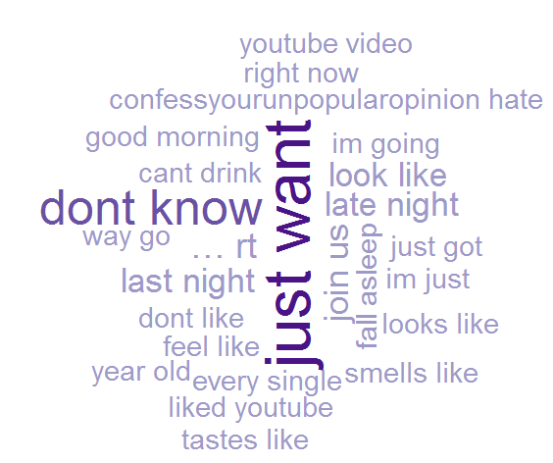
Commonality Cloud
The tweets mentioning “chardonnay” “beer”, and “coffee” have these words in common.
Again size is related to frequency.
Not helpful in this but in diverse corpora it may be more helpful e.g. political speeches.
Freq Counts, Dendrograms
Wordclouds

Slide 47
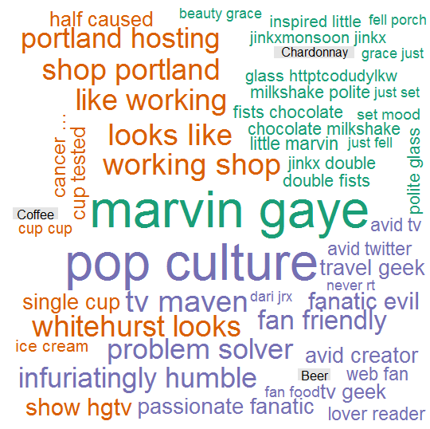
Comparison Cloud
The tweets mentioning “chardonnay” “beer”, and “coffee” have these dissimilar words.
Again size is related to frequency.
Beer drinkers in this snapshot are passionate (fanatics, geeks, specialists) on various subjects while Chardonnay drinkers mention Marvin Gaye. Coffee mentions up & working.
Freq Counts, Dendrograms
Wordclouds

Slide 48
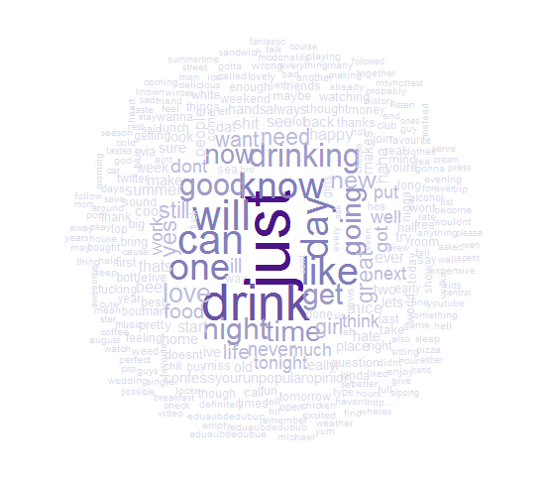
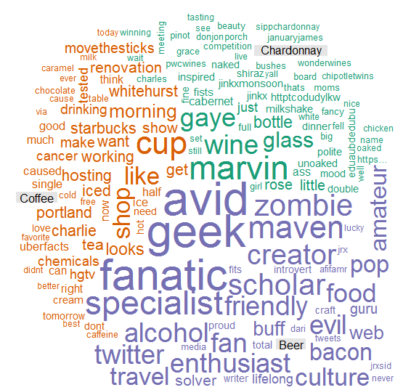
Both Clouds look very different with different tokenization
Freq Counts, Dendrograms
Wordclouds

Slide 49
Topic Modeling & openNLP
What is Text Mining?
String Manipulation
Cleaning
Freq Counts, Dendrograms
Wordclouds
Topic Modeling
openNLP

Slide 50
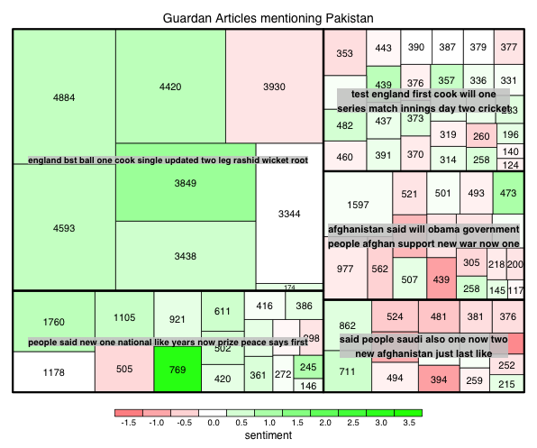
7_Topic_Modeling_Sentiment.R
TREEMAP: multi dimensional representation of the corpus attributes.
Setup
Color will represent quick, simple polarity sentiment
Each article is a small square
The area of the square is related to the number of terms document length
The larger grouping is based on LDA or CTM Topic Modeling
End result is understanding broad topics, their sentiment and amount of the corpus documents devoted to the identified topic.
Topic Modeling
openNLP

Slide 51
Topic Modeling
LDA
Example
Each document is made up of mini topics.
Corpus
I like to watch basketball and football on TV.
I watched basketball and Shark Tank yesterday.
Open source analytics software is the best.
R is an open source software for analysis.
I use R for basketball analytics.
Probability is assigned to each document for the specific observed topics.
A document can have varying probabilities of topics simultaneously.
LDA Topics
Topic A: 30% basketball, 20% football, 15% watched, 10% TV…something to do with watching sports
Topic B: 40% software, 10% open, 10% source…10% analytics something to do with open source analytics software
Technical Explanations:
http://en.wikipedia.org/wiki/Latent_Dirichlet_allocation
http://cs.brown.edu/courses/csci2950-p/spring2010/lectures/2010-03-03_santhanam.pdf
*Full disclosure I am not an expert in topic modeling
Documents
100% Topic A
100% Topic A
100% Topic B
100% Topic B
60% Topic B, 40% Topic A

Slide 52
Simple Sentiment Polarity
Scoring
Zipf’s Law
Surprise is a sentiment.
Hit by a bus! – Negative Polarity
Won the lottery!- Positive Polarity
Many words in natural language but there is steep decline in everyday usage. Follows a predictable pattern.
I loathe BestBuy Service -1
I love BestBuy Service. They are the best. +2
I like shopping at BestBuy but hate traffic. 0
R’s QDAP polarity function scans for positive words, and negative words as defined by MQPA Academic Lexicon research. It adds positive words and subtracts negative ones along with valence shifters. The final score represents the polarity of the social interaction.

Slide 53
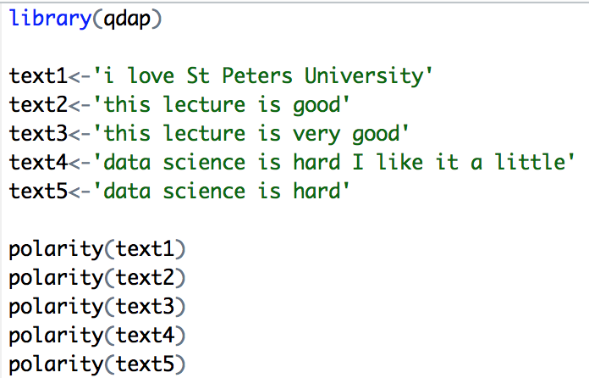
Simple Sentiment Polarity
Scoring
Text 1: “love” was identified as positive. The text has 5 words and so 1/sqrt(5) = .447
Text 2: “good” was identified positively. So 1/sqrt(4)=.5
Text 3: “good” was found along with the amplifier “very”. So (.8+1)/sqrt(5)=.805
Text 4: hard and like cancel each other out so the polarity is zero. 1-1/sqrt(9)=0
Text 5: “hard” is -1/sqrt(4)=-.50
First it looks for the polarized word. Then identifies valence shifters (default 4 words before and two words after) Amplifiers are assigned +.8 and de-amplifiers weight is constrained to -1.

Slide 54
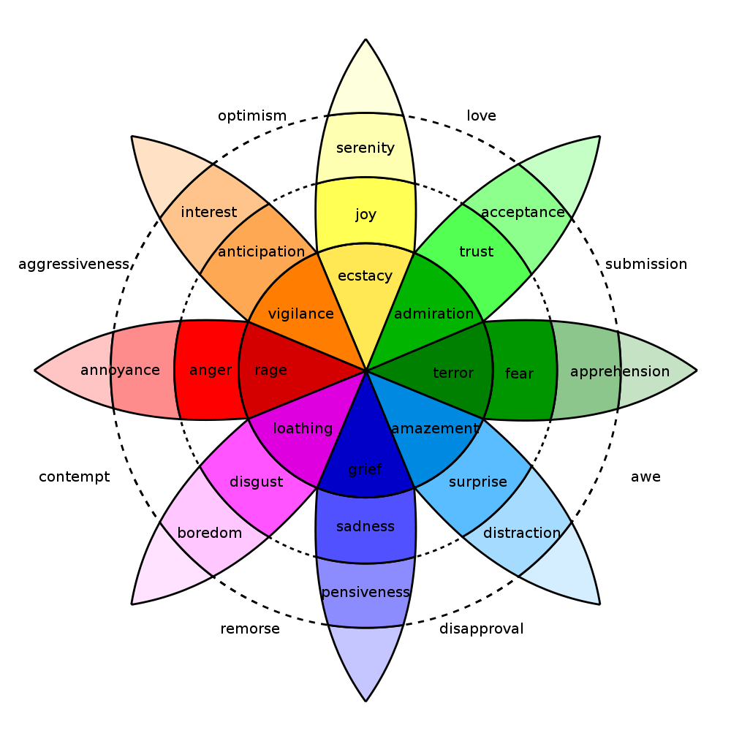
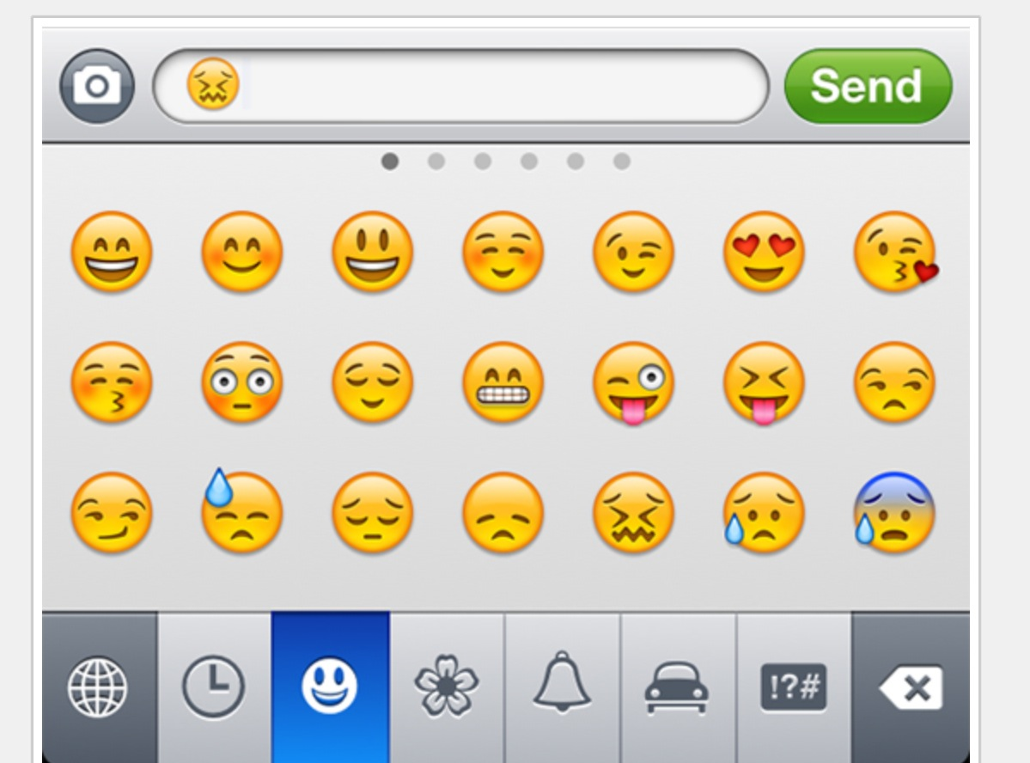
In reality sentiment is more complex.
Many Many Emoji
Plutchik’s Wheel

Slide 55
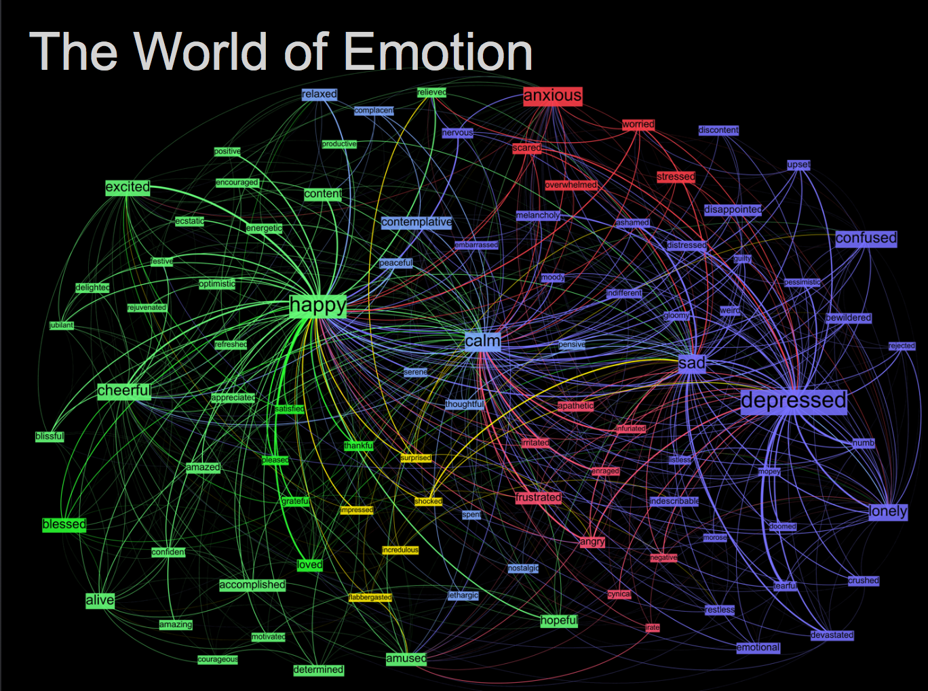
Kanjoya’s Experience Corpus

Slide 56
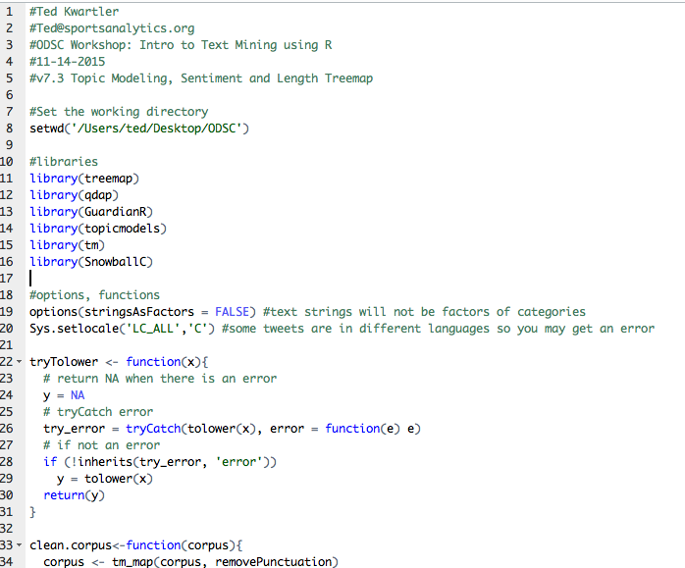
7_Topic_Modeling_Sentiment.R
Open the script and let’s walk through it line by line because there are multiple additions to the previous scripts
Setup
Topic Modeling
openNLP

Slide 57
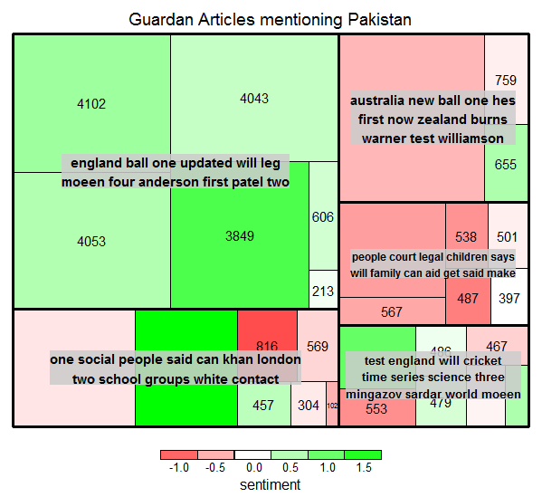
7_Topic_Modeling_Sentiment.R
Treemap shows a wider topic sentiment and length range.
“Pakistan” Guardian Mentions
11-1 to 11-8
English Cricket
longer & positive
Australian & NZ Cricket
Long & Negative
Taliban
More numerous & Negative
Topic Modeling
openNLP

Slide 58
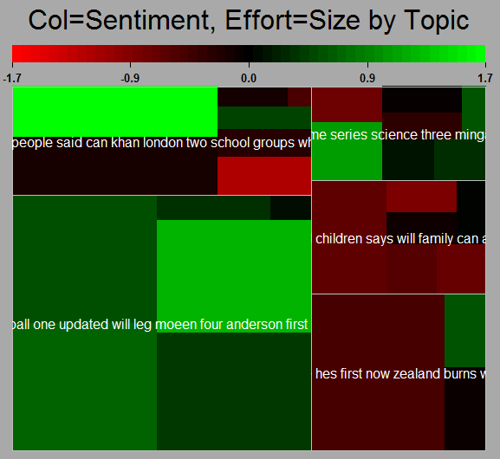
7_Topic_Modeling_Sentiment.R
Using the portfolio package is a bit easier but more limited
Setup
Topic Modeling
openNLP

Slide 59
Remember this? Text Mining Approaches
“Lebron James hit a tough shot.”
Semantic Using Syntactic Parsing
Bag of Words
Lebron
a
James
hit
tough
shot
What is Text Mining?

Slide 60
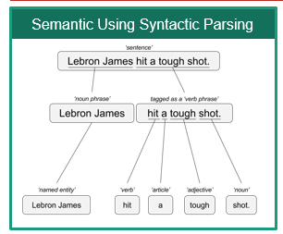
8_Open_Language_Processing.R
library(openNLP)
Setup
https://rpubs.com/lmullen/nlp-chapter
Uses Annotators to identify the specific item in the corpus. Then holds all annotations in a plain text document. Think of auto-tagging words in a document and saving the document terms paired with the tag.
Documentation, examples are hard to come by!
Annotations
Grammatical or POS (Part of Speech) Tagging
Sentence Tagging
Word Tagging
Named Entity Recognition
Persons
Locations
Organizations
Topic Modeling
openNLP

Slide 61
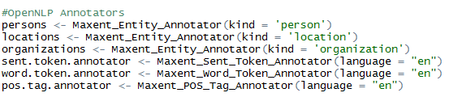
8_Open_Language_Processing.R
Annotations Specified
Setup
Annotations Applied to Text
Topic Modeling
openNLP

Slide 62
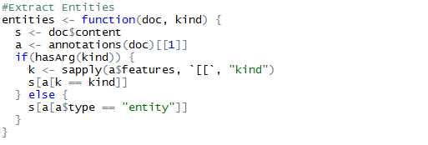
8_Open_Language_Processing.R
Setup
The annotated plain text object is large with a complex structure. This function allows us to extract the tokens by tag kind.
Topic Modeling
openNLP

Slide 63
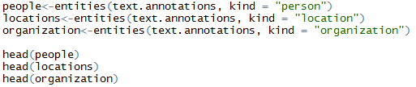
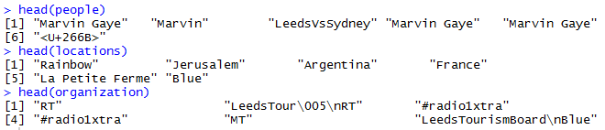
8_Open_Language_Processing.R
The function creates a vector of people, locations and orgs that were “recognized”
Setup
Topic Modeling
openNLP

Slide 64
Questions?
@tkwartler
www.linkedin.com/in/edwardkwartler
https://github.com/kwartler/ODSC_West_2016

